Slide 1


Slide 2
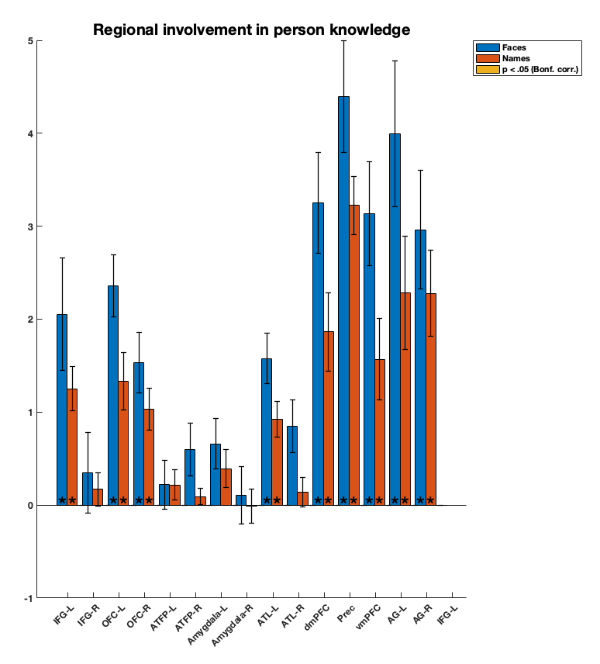
*

Slide 3
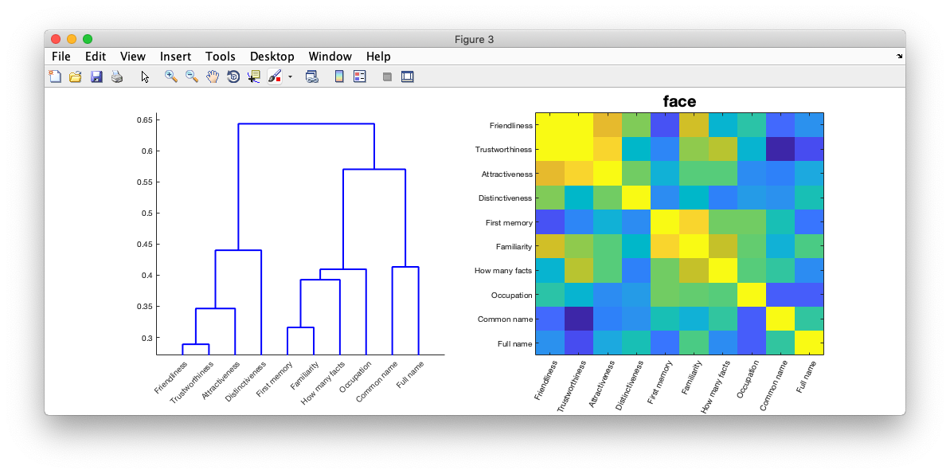
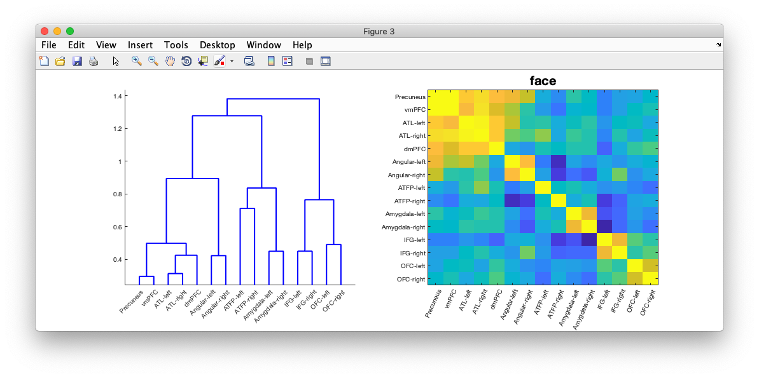
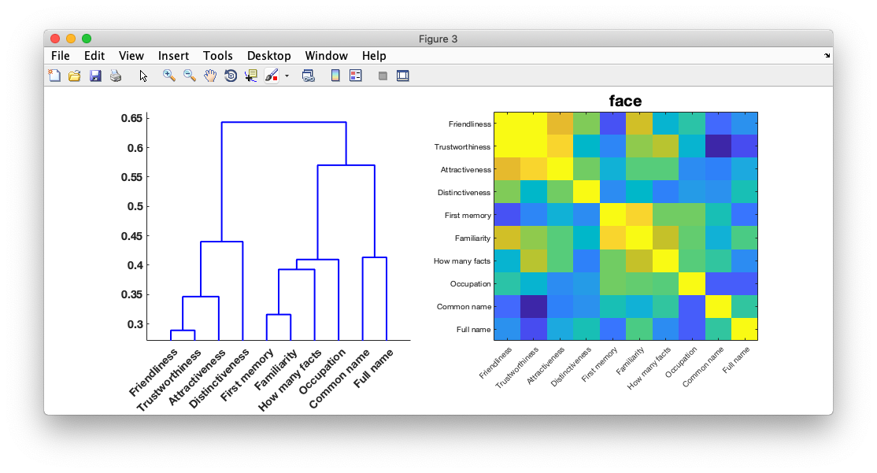
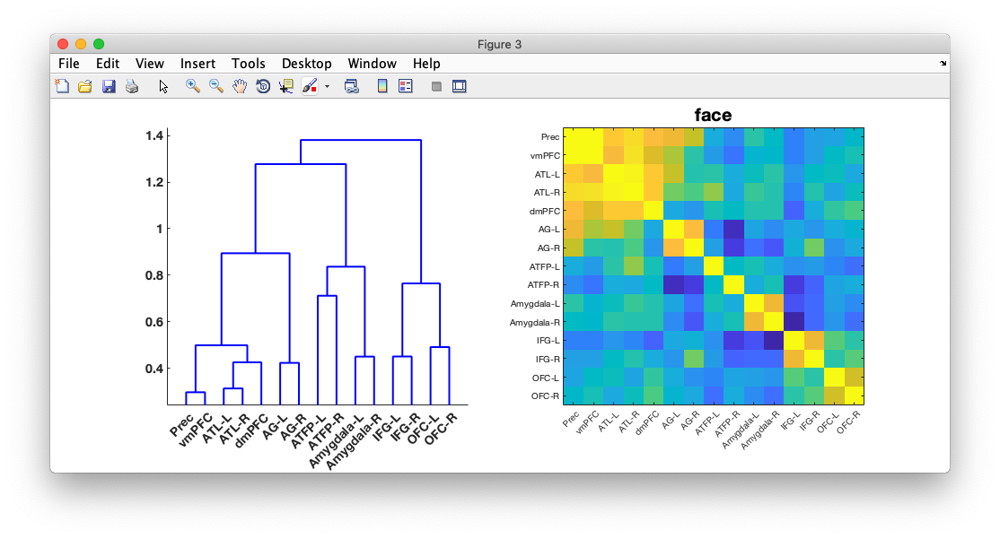
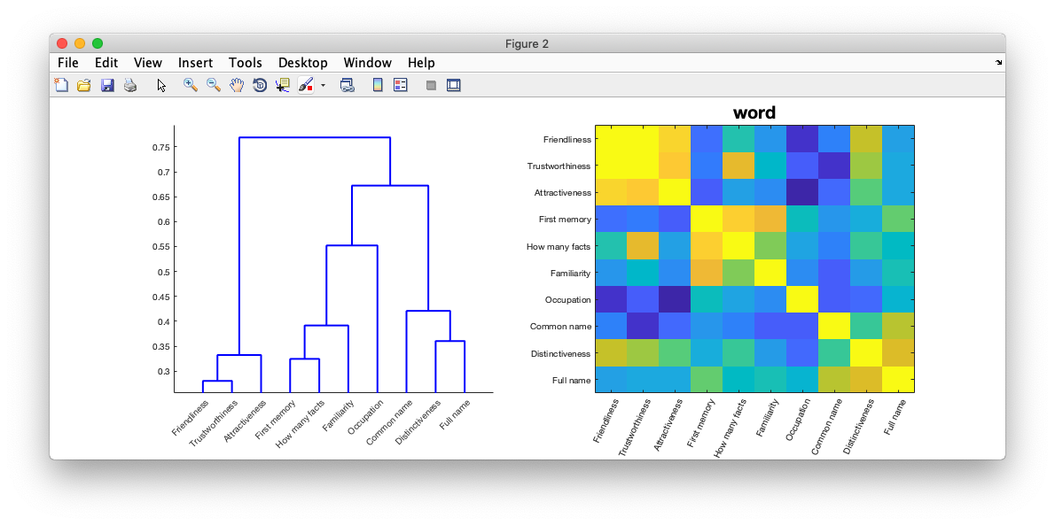
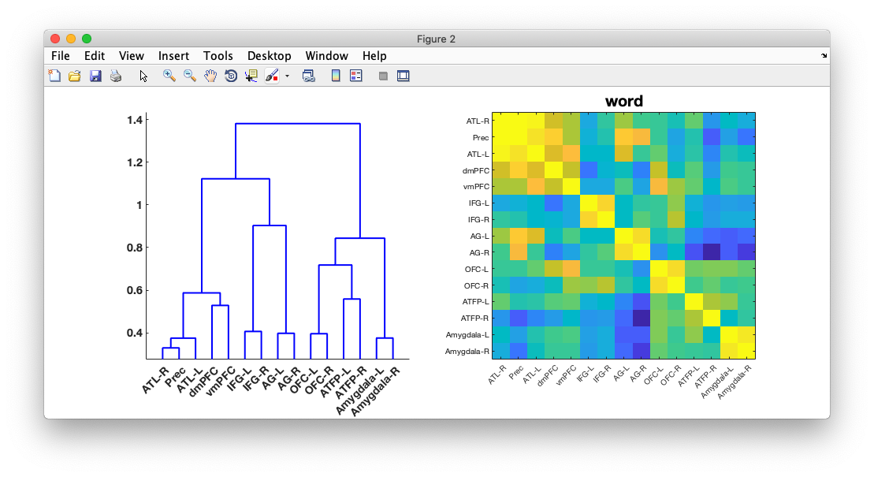
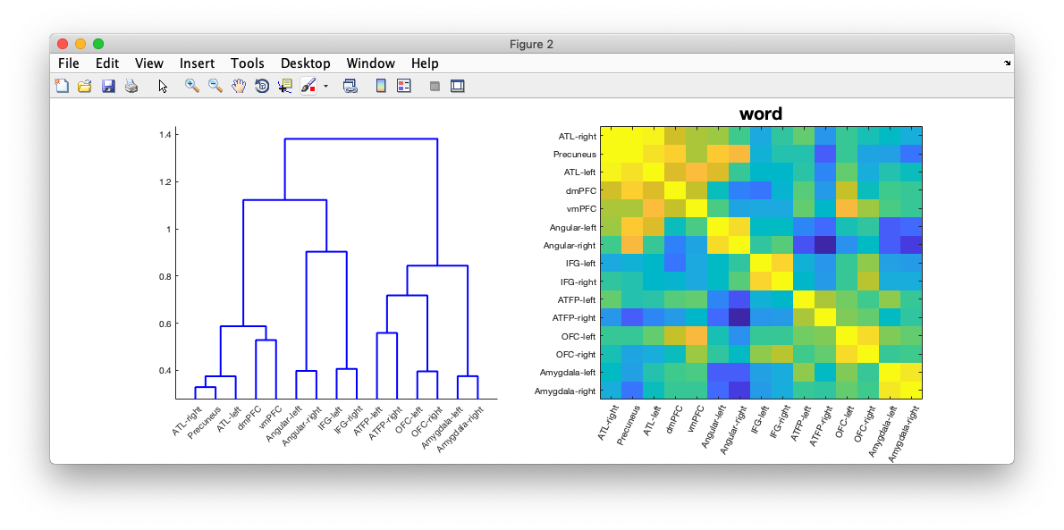
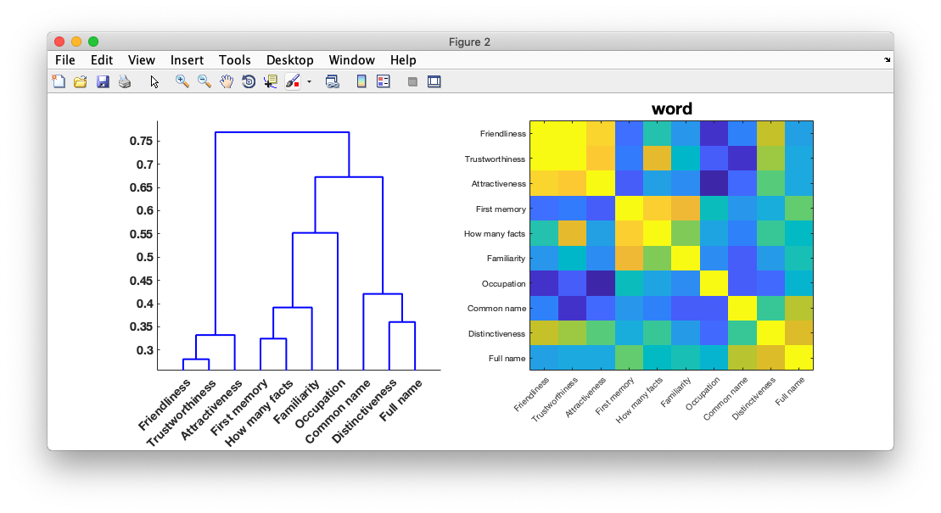
Faces
Model
Model
Correlate
Correlate
Data
Data
Names

Slide 4
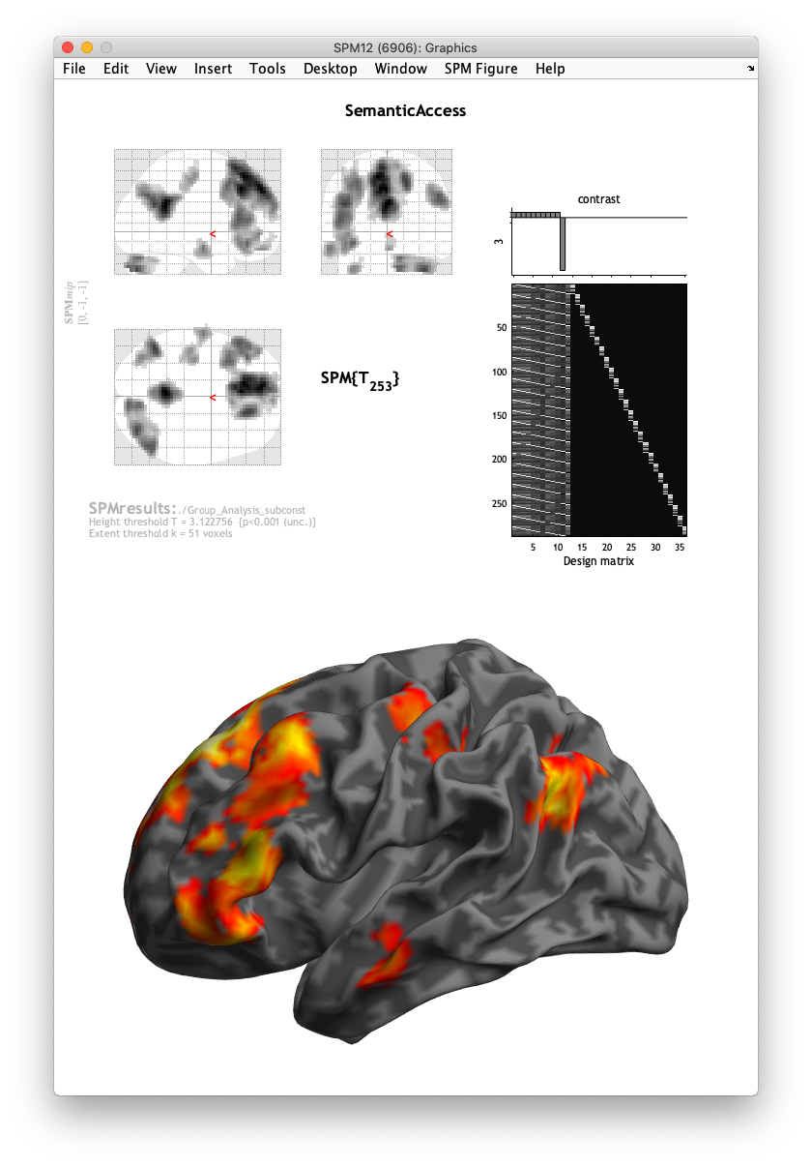
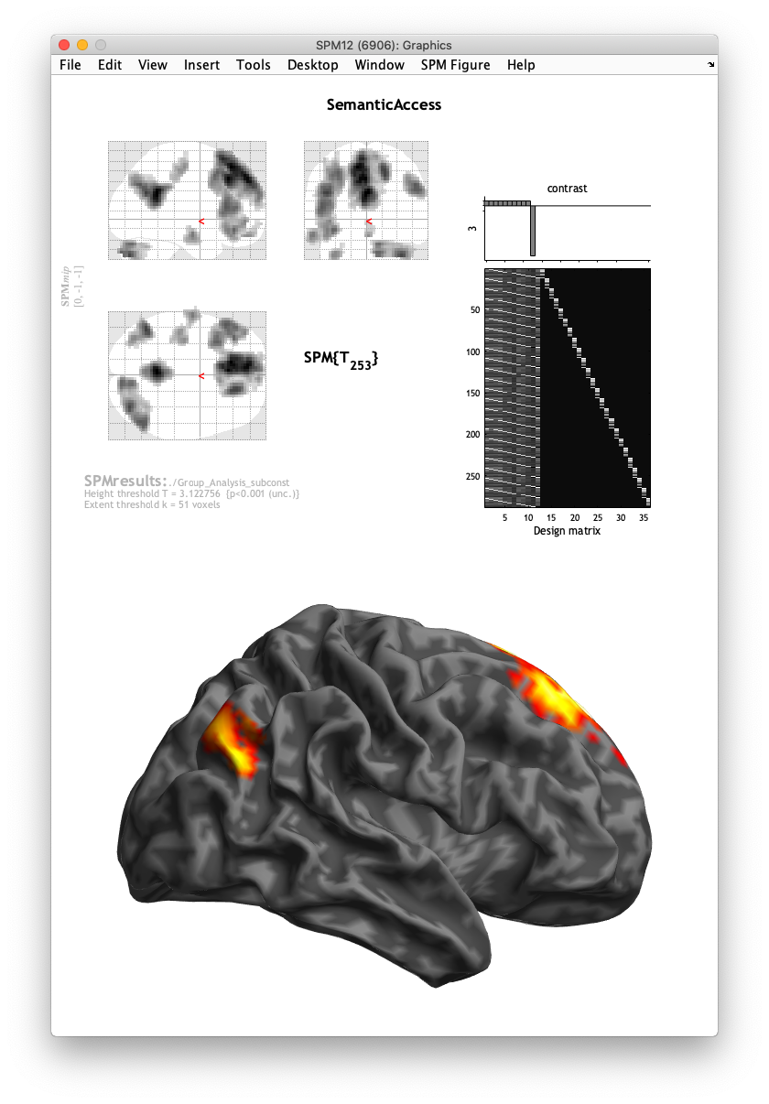
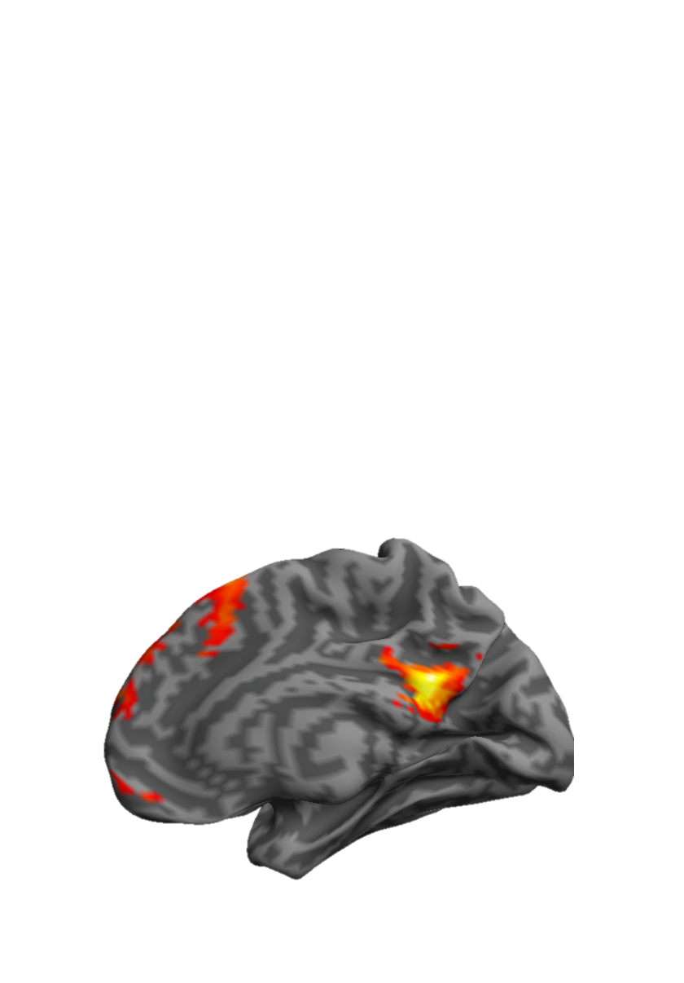
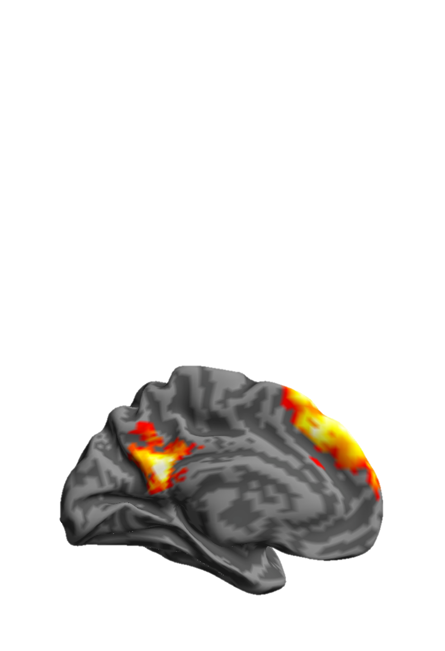
Names
Voxel p < .001
Cluster p < .05

Slide 5
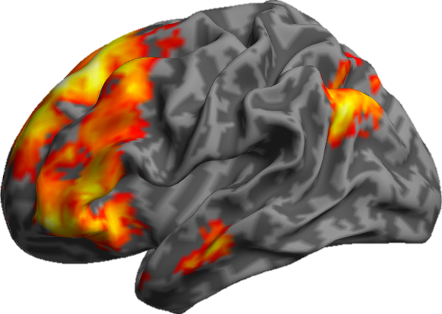
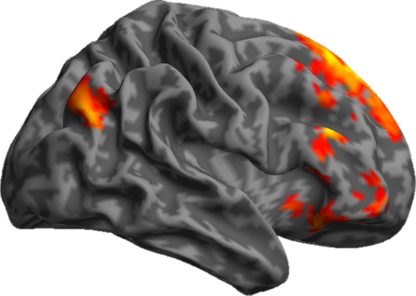
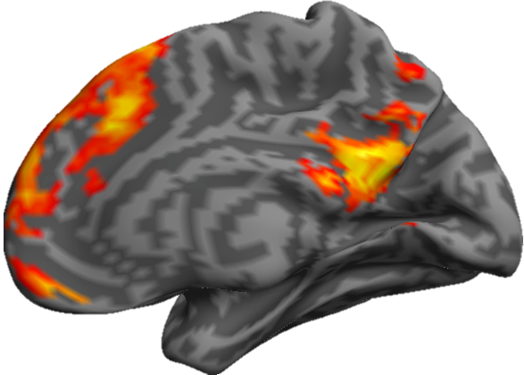
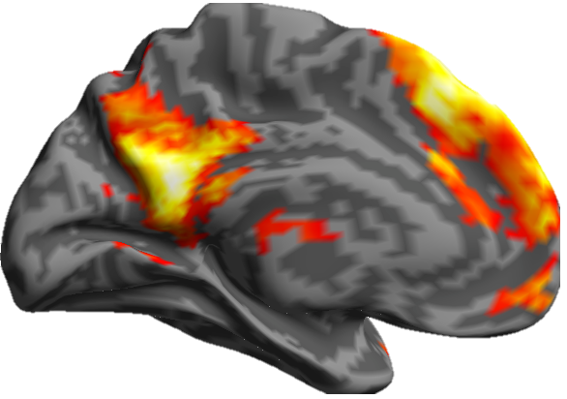
Faces

Slide 6
Names
Faces
Voxel p < .001
Cluster p < .05

Slide 7
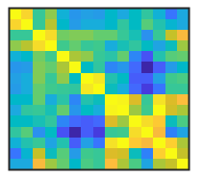
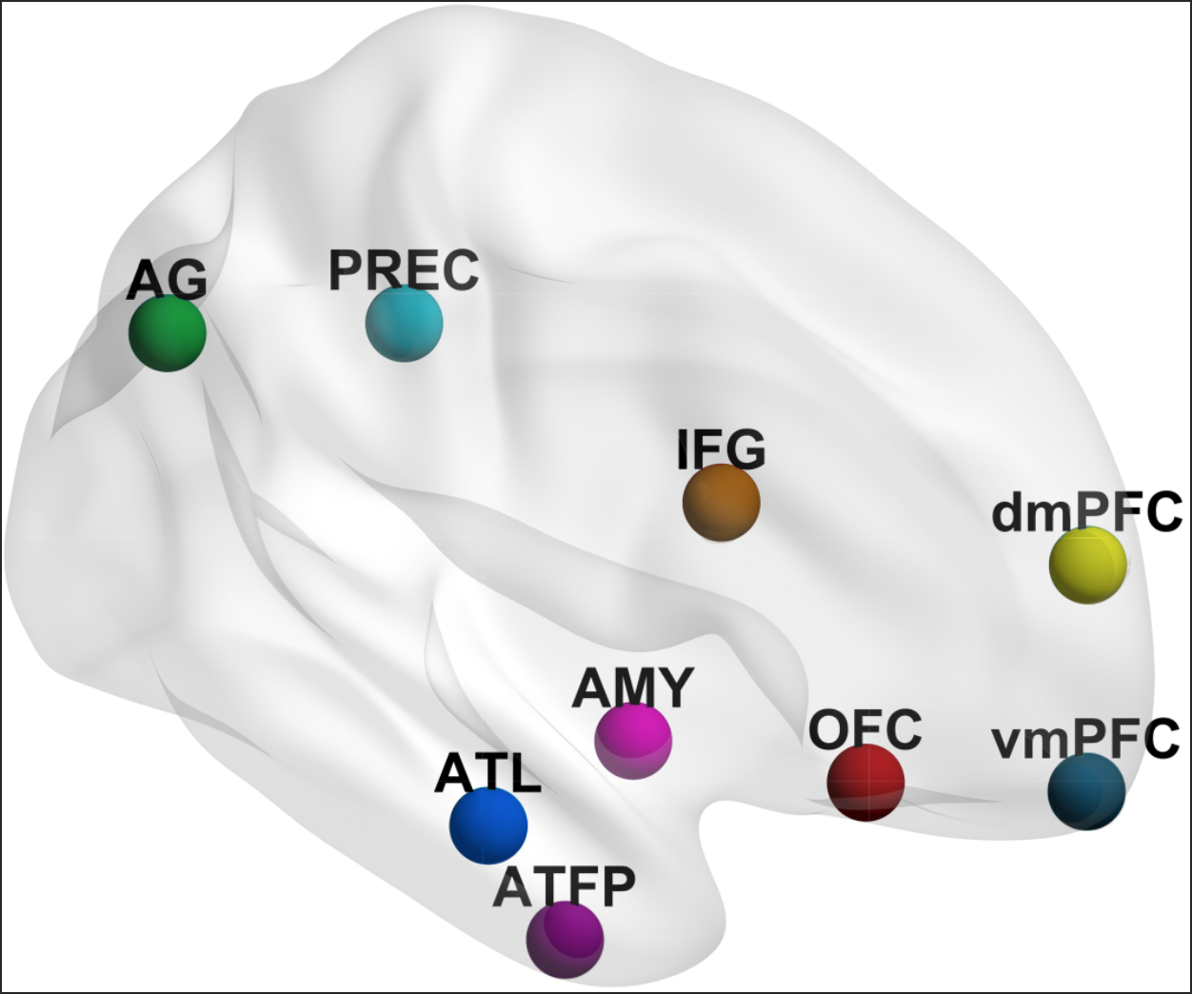
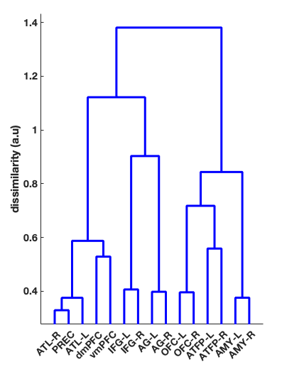
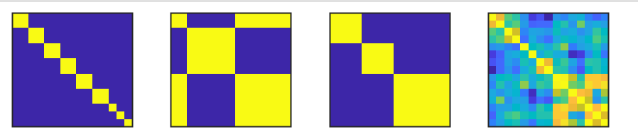
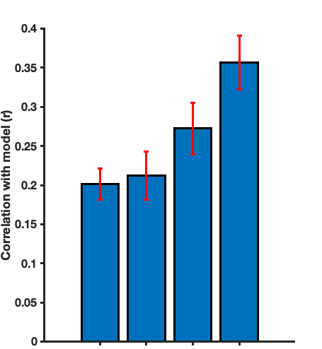
Pairwise Similarity Matrix
Regional similarity hypotheses
Regional Similarity Dendrogram
Pattern Similarity Matrix
Pattern similarity
Model fit
Pairs
Posthoc
Model fit comparison
*
**
**
*
* p < .05
*
** p < .001
n.s
Internalised/Externalised/Control
Empirical
Pairs
I/E/C
Posthoc
Empirical

Slide 8
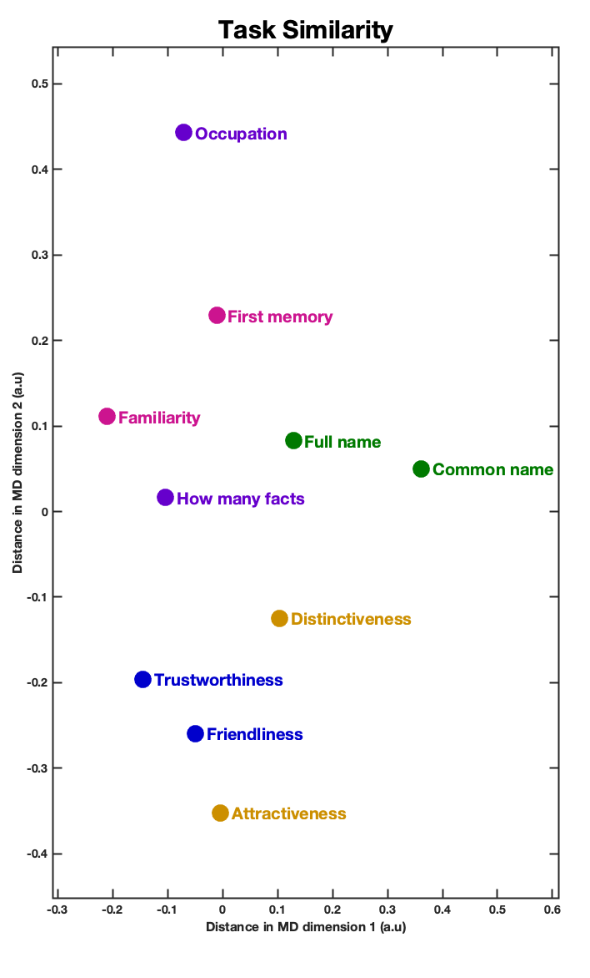
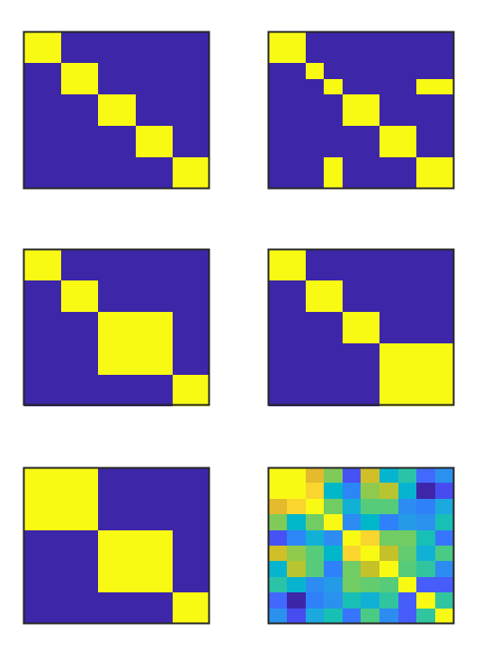
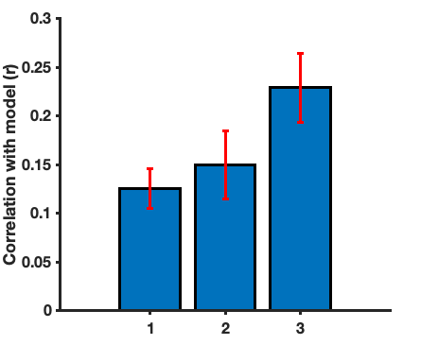
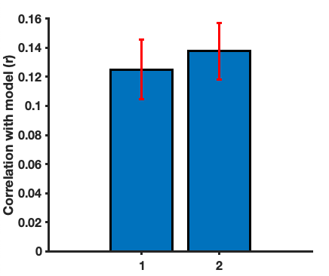
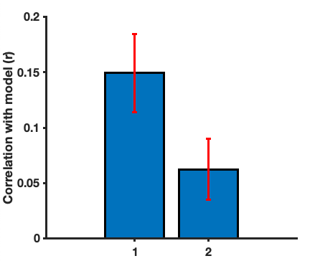
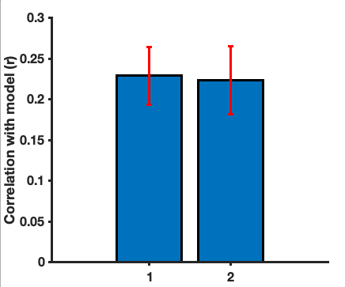

Model comparison Procedure
Pairs
Episodic+Biographical
Macro-Domain
**
**
Similarity model fit
Pairs posthoc
Episodic+Nominal
Empirical Model
Pairs
Ep+Bio
Model Visualisation
Macro-Domain
Best Model Macro Domain Grouping
Social/Perceptual judgements
n.s
*
n.s
Memory
Pairs
Ep+Bio
Nominal Knowledge
Pairs posthoc
Ep+Nom
Macro-Domain
Empirical Model

